Slide 1

Exploratory Data analysis
DSC 530 (Winter 2025)
Pankaj Yadav

Slide 2
Github link
https://github.com/pankajsyadav/EDA2024

Slide 3

Question:
Is there an impact of your grades on your final salary?
On a generic scale, men are offered a higher salary than women.

Slide 4

Data summary
Kaggle is used as a source and Placement data for full class is used for this analysis
There are 15 columns and 215 rows in the file
Data frame contains final percentages for 10th grade, 12th grade, Undergrad, employability test and Graduation.
It does provide categorical information like gender, placement status, work experience, specializations in undergrad and graduate program.
Salary is provided for students who were placed before term end.

Slide 5
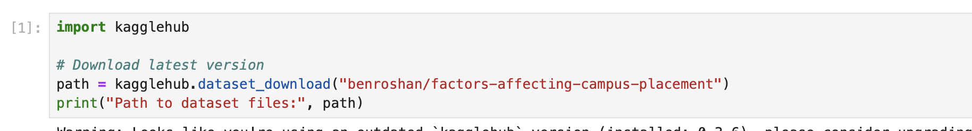
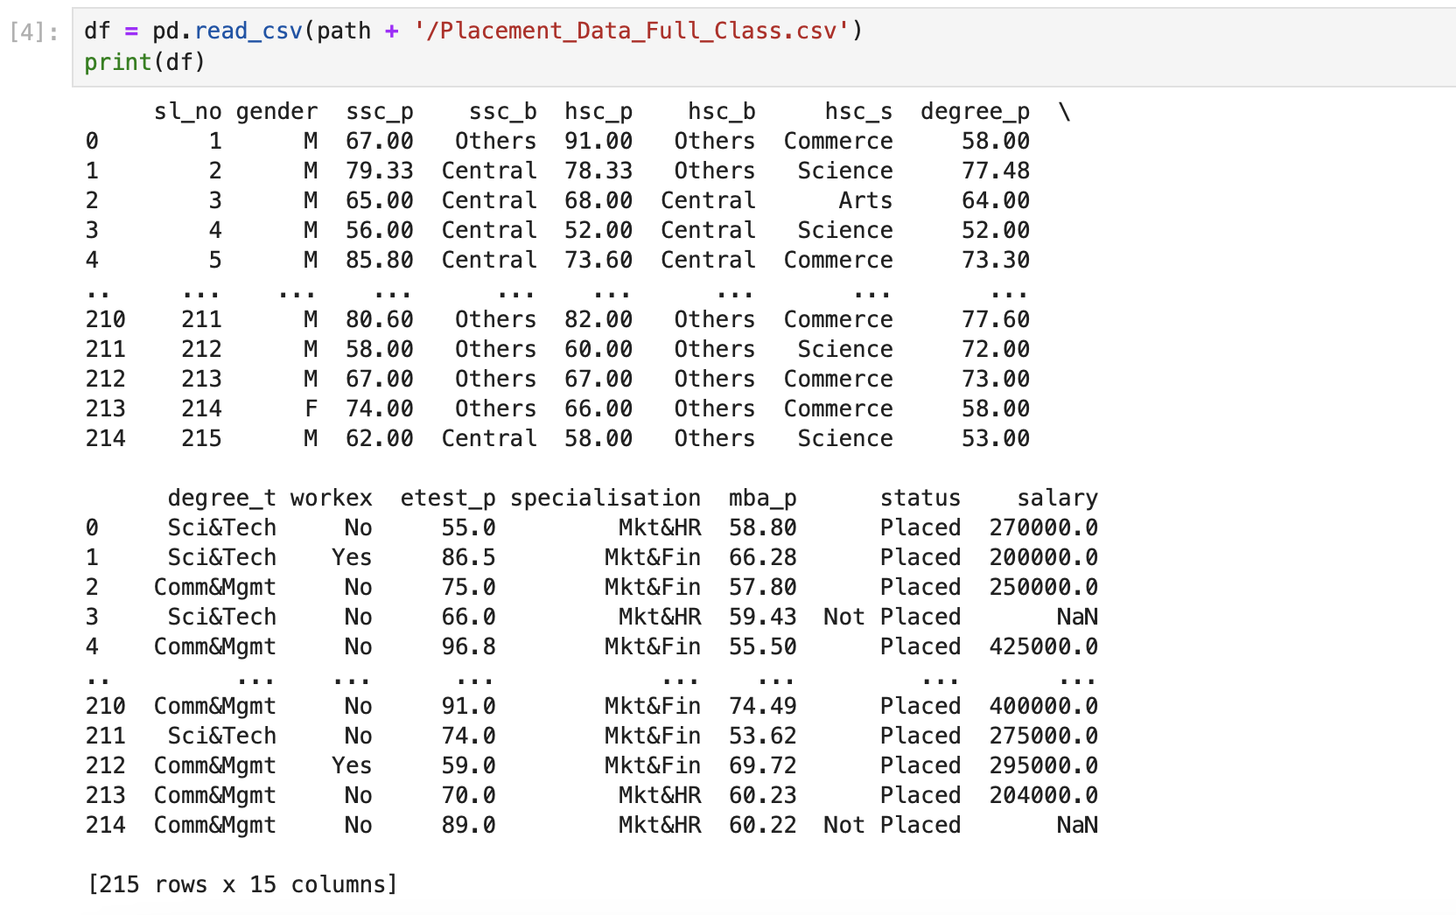
Data frame Details

Slide 6
Variable description
1. sl_no ~ Serial Number is integer record number
2. gender ~ Gender where code M is for So, and F is for Female
3. ssc_p ~ 10th Grade Percentage
4. ssc_b ~ 10th Grade School Board. In India schools are affiliated to State of federal government education boards. Central is used for federal school board
5. hsc_p ~ 12th Grade Percentage
6. hsc_b ~ 12th Grade School Board. In India schools are affiliated to State of federal government education boards. Central is used for federal school board
7. hsc_s ~ 12th Grade specialization. If student chose a Science (STEM), Arts (liberal arts) or Commerce (Accounting and Comptroller) specialization
8. degree_p ~ Undergrad Percentage
9. degree_t ~ Undergrad Specialization
10. workex ~ Prior Work Experience. Yes means the student posses work experience before opting in for masters
11. etest_p ~ Employability Test Percentage. Checks your readiness for employability.
12. specialisation ~ Graduation ( MBA ) Specialization. Fin is for Finance and HR for Human Resources
13. mba_p ~ MBA Percentage
14. status ~ Status if placed in Job or not placed
15. salary ~ Salary Offered if placed
In the dataset, I will utilize the percentages at each level ( 10th , 12, undergrad and grad) along with employability test to evaluate student’s performance at each level and check if the percentages in those tests correspond to the salary increase or increased your chances of placement. So, the Variables SSC_P ( 10th Grade Percentage) , HSC_P ( 12th grade percentage ) , Degree_P ( Undergrad Percentage ), estest_P ( employability test percentage) , MBA_P ( Graduation percentage ) and Salary along with status which will provide us the chances of a student getting placed in a job are the variables used to analyze the data and are top variables for analysis..

Slide 7
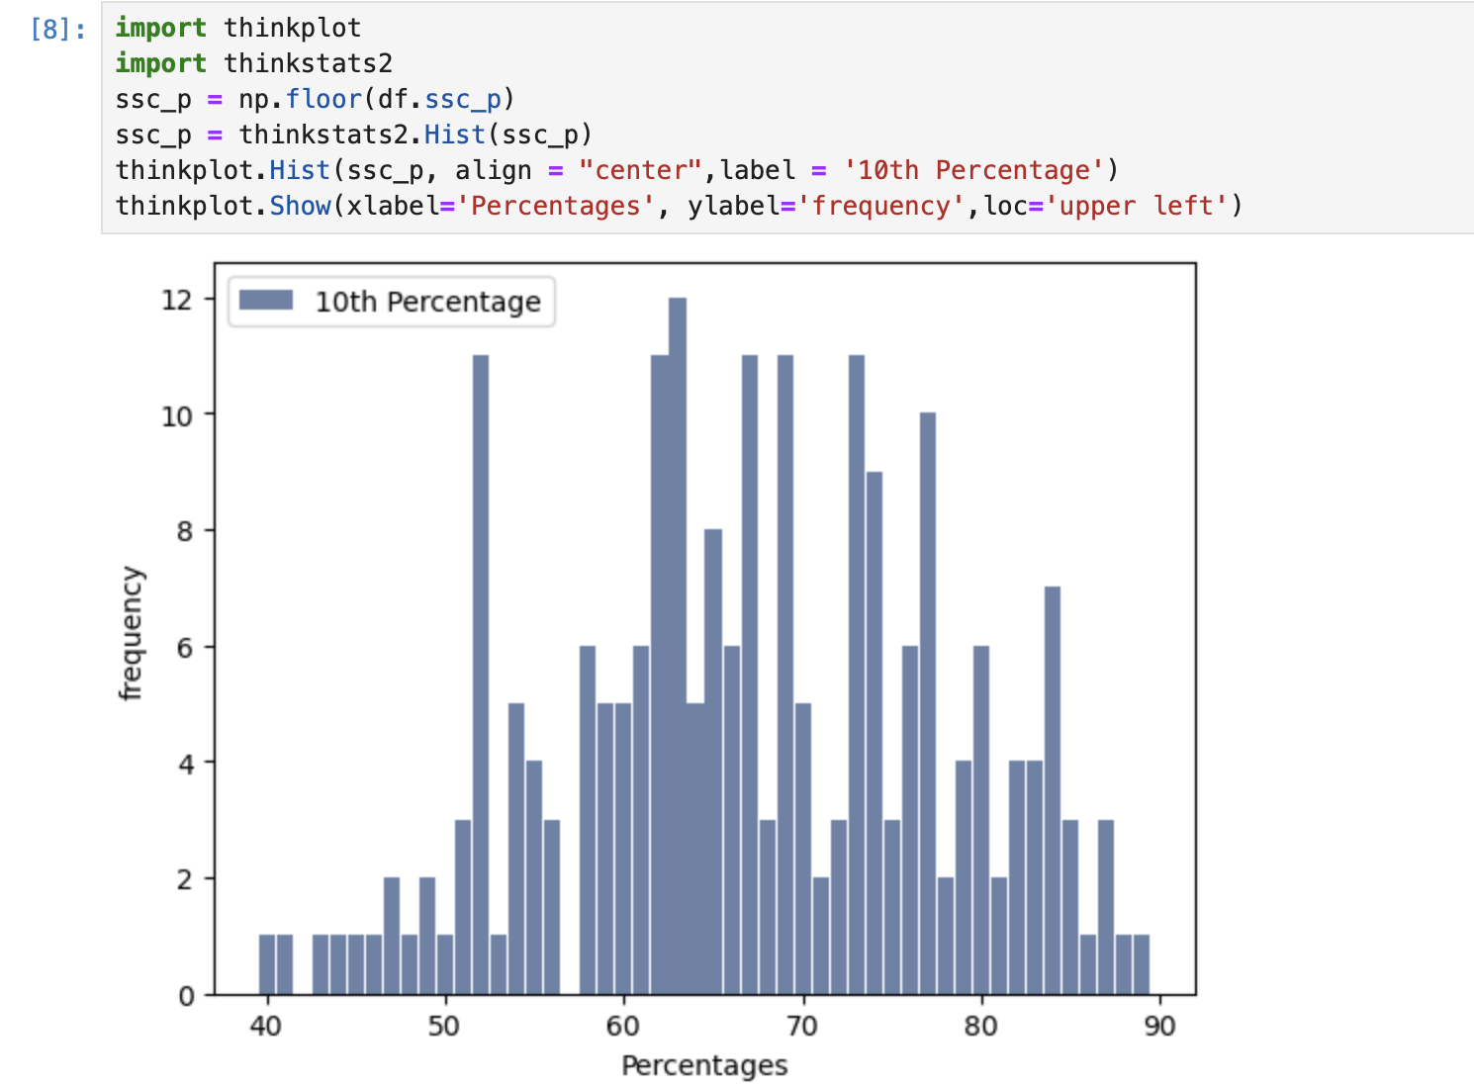
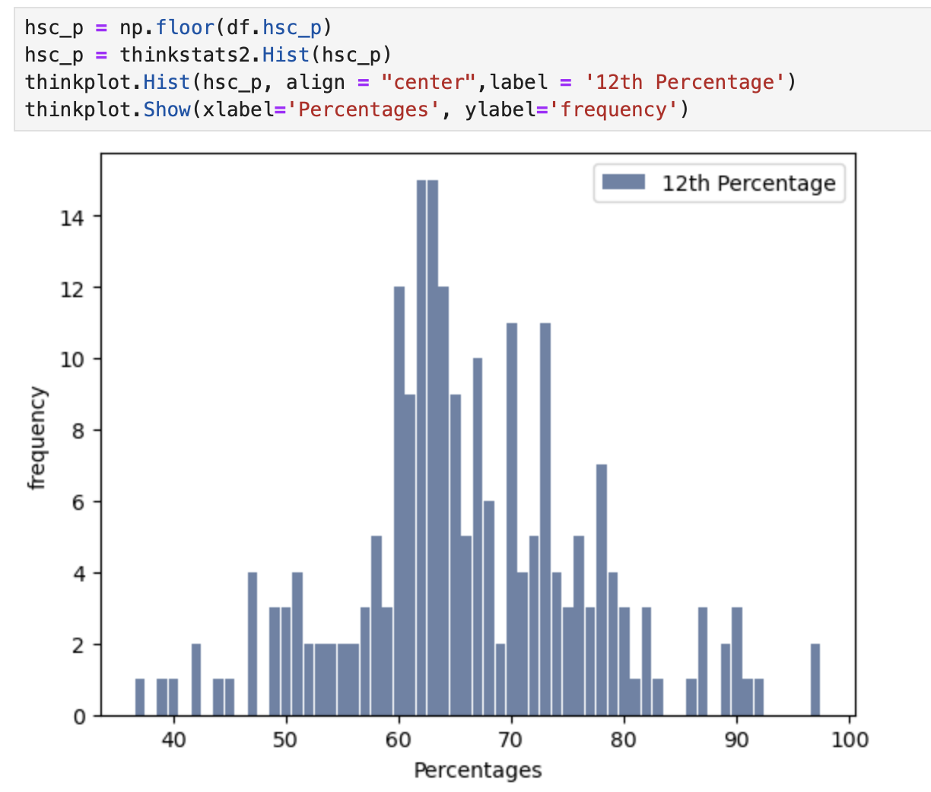
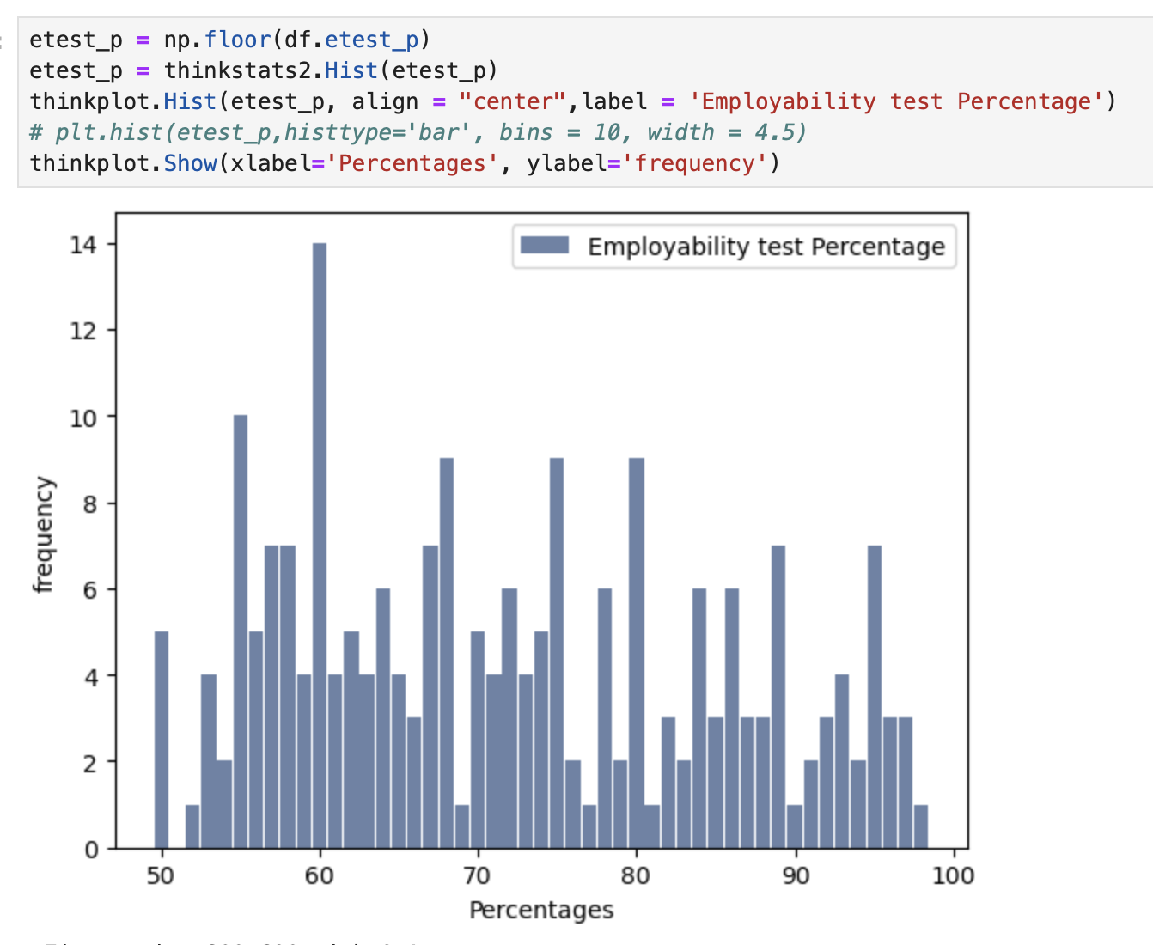
Histograms
The histogram for ssc_p variable which is percentage in 10th grade is slightly right skewed, bimodal.
As percentages are not very low or high, the data looks free of outliers.
The histogram for hsc_p variable which is percentage in 12th grade looks normally distributed. Its unimodal data and free of outliers
The histogram for etest_p variable which is performace in employability test looks uniformly distributed across all values and is multimodal. Percentages shows no outliers

Slide 8
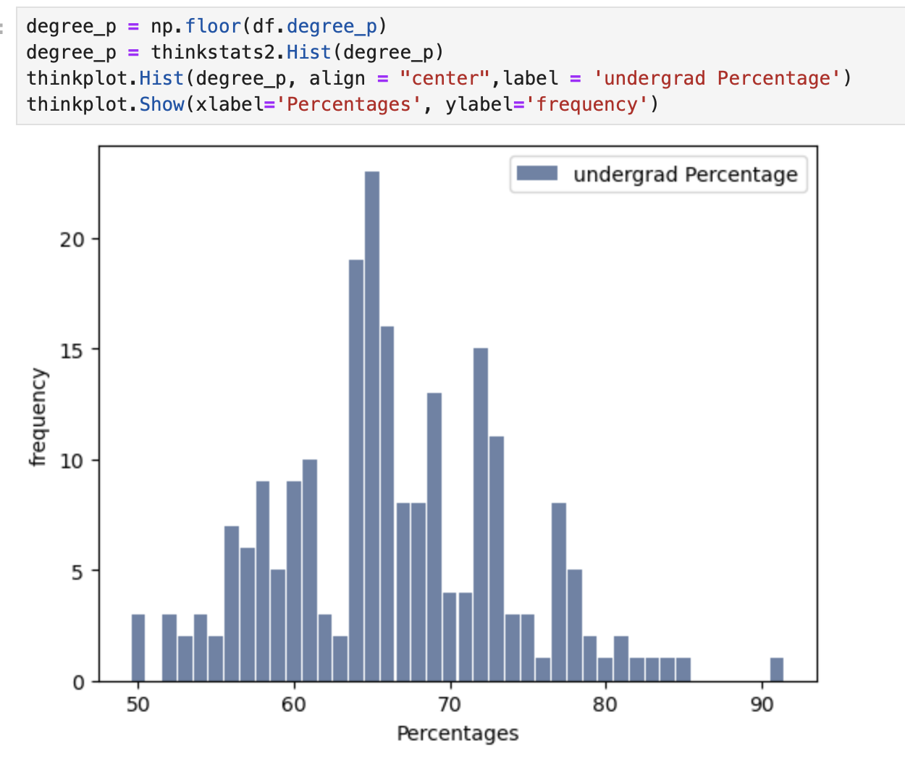
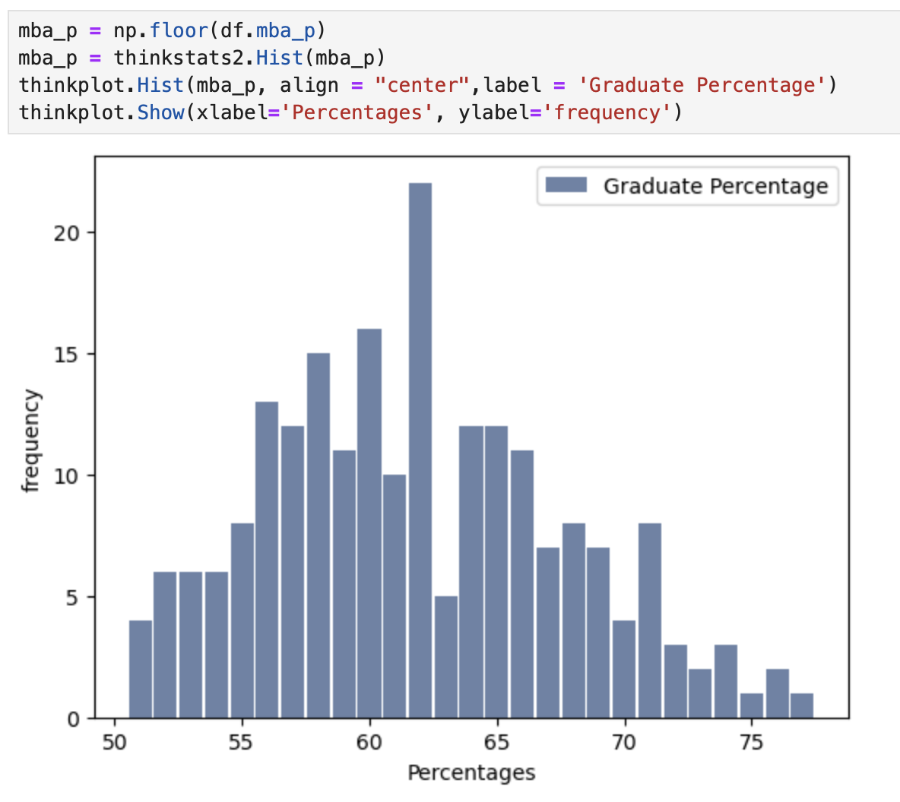
Histograms Cont..
The histogram for degree_p variable which is percentage in undergrad is slightly left skewed, unimodal & normal. One student percentage was shown as outlier and >90% but the student was a high performer across other grades too
The histogram for mba_p variable which is percentage in undergrad is slightly left skewed, unimodal & normally Variable is free of outliers

Slide 9
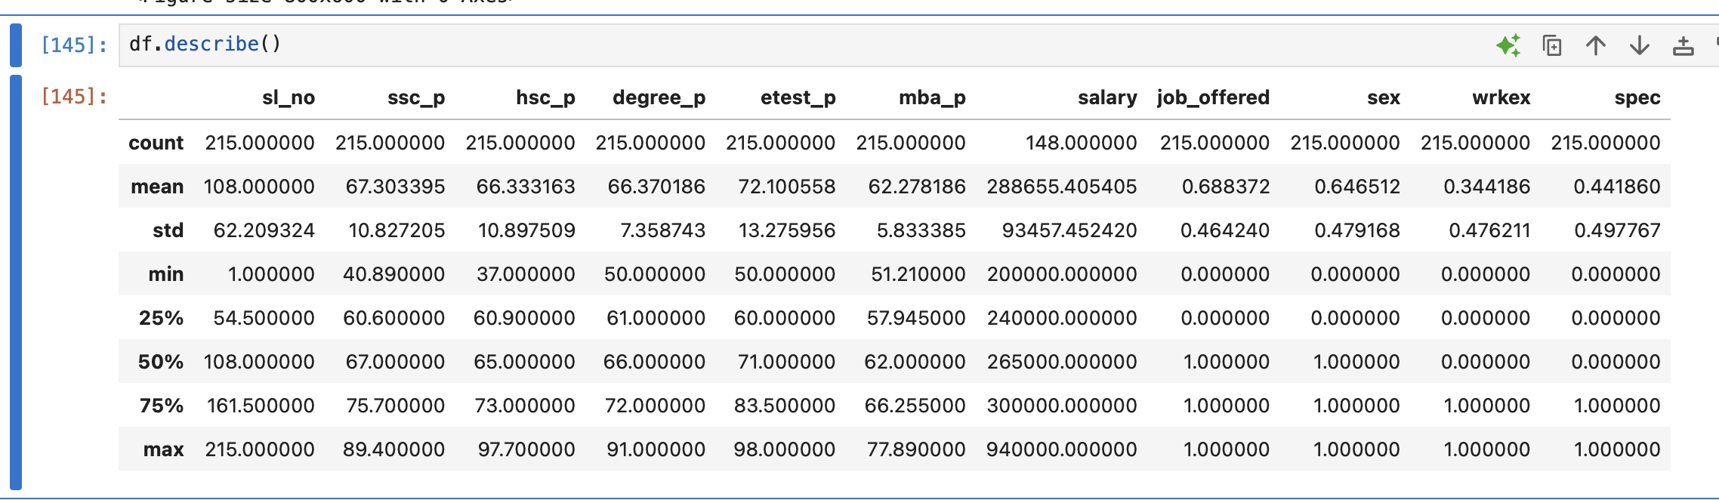
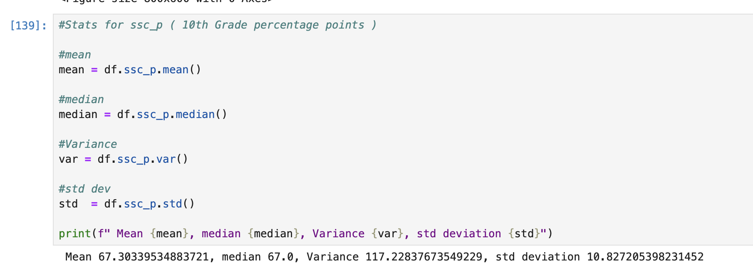
Descriptive characteristics

Slide 10
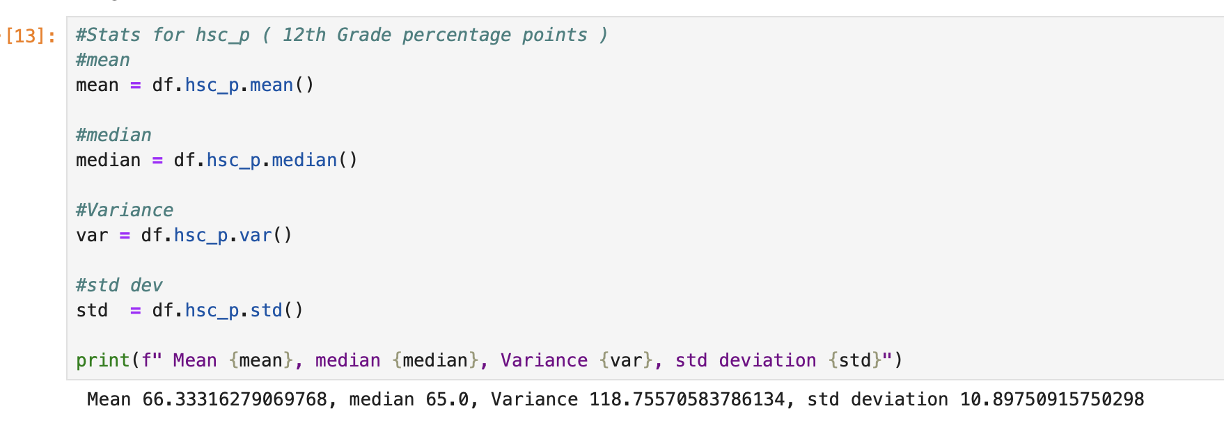
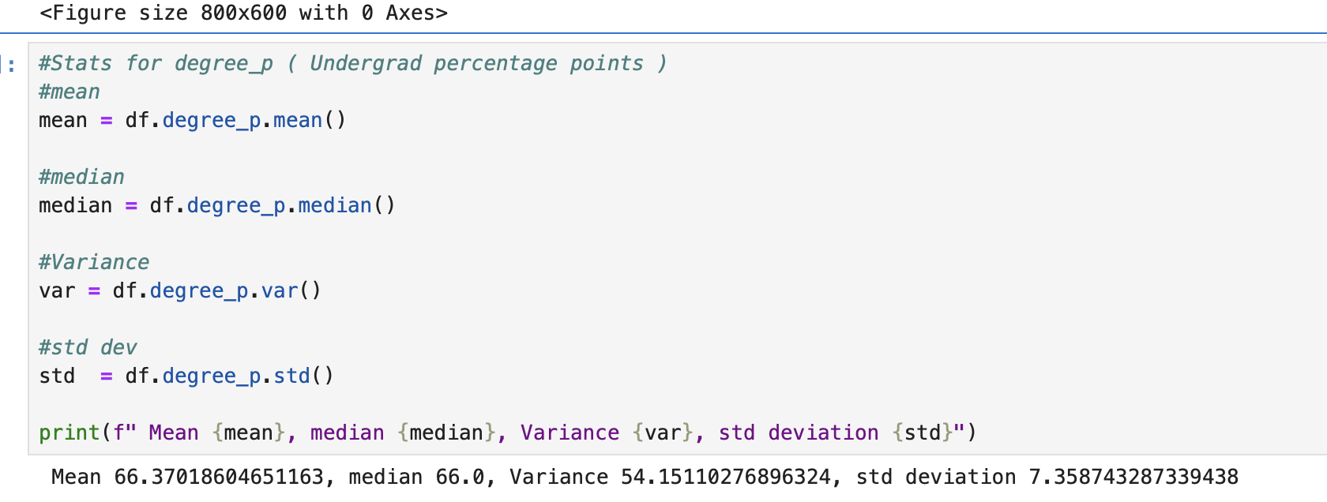
Cont..

Slide 11
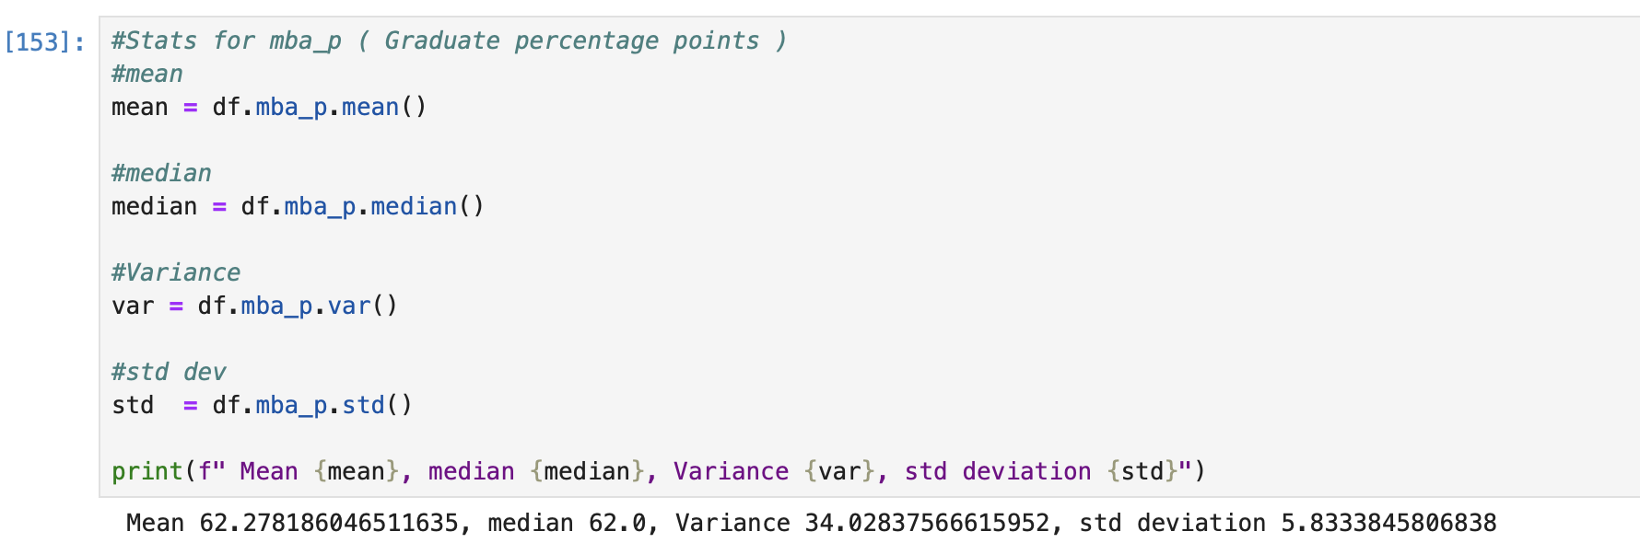
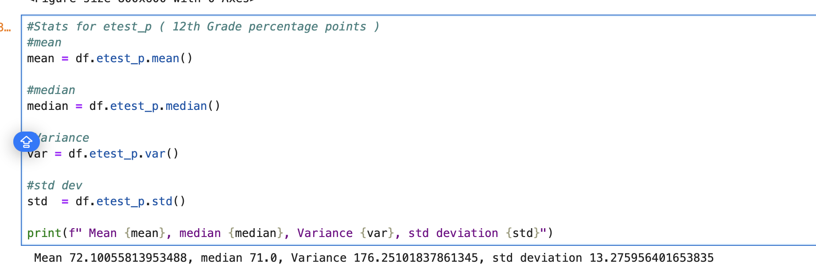
Cont..

Slide 12
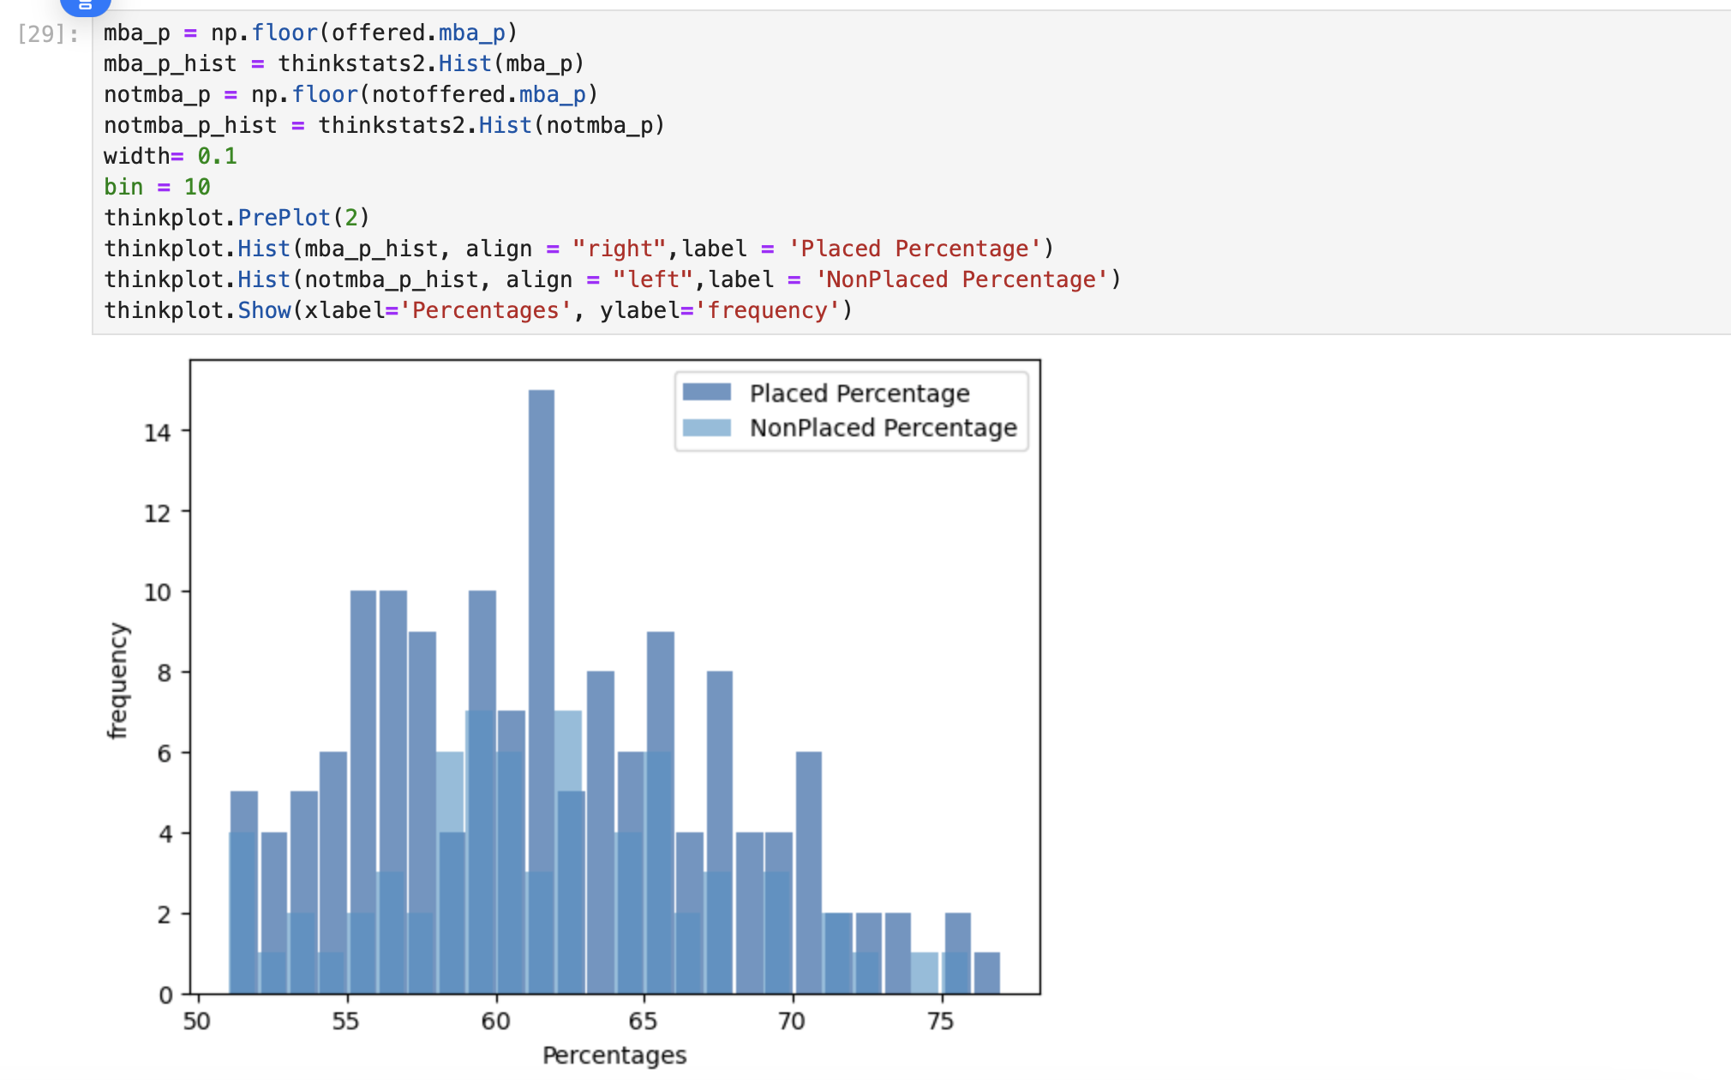
PMF
The histogram between placed and not placed students
Next, create PMF and compare the two

Slide 13
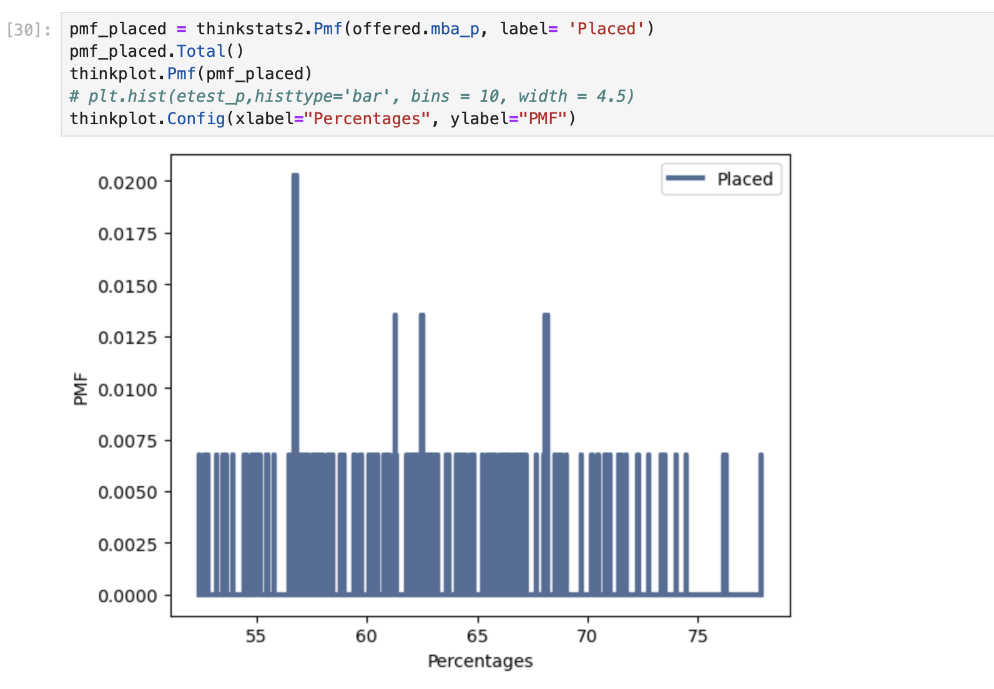
PMF cont..
PMF for students got placed. You see the probabilities of placements are pretty much same across except at few percentage levels. This could be due to the small population.

Slide 14
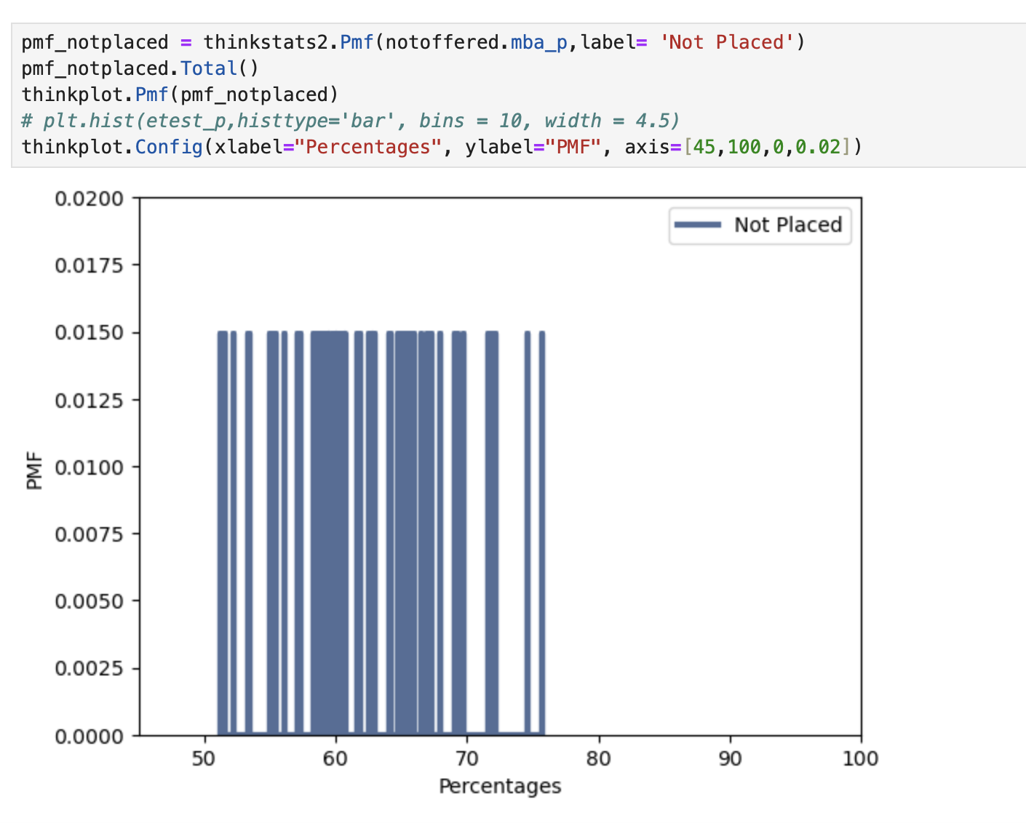
PMF Cont..
PMF for students not getting placed. You see the probabilities are pretty much same across between the range of 50 to 75%. This could be due to the small population.

Slide 15
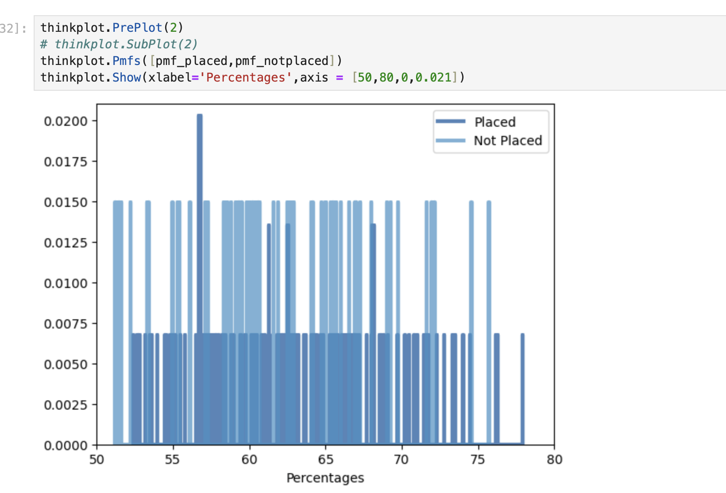
PMF Cont.
Comparing two PMF using step plot

Slide 16
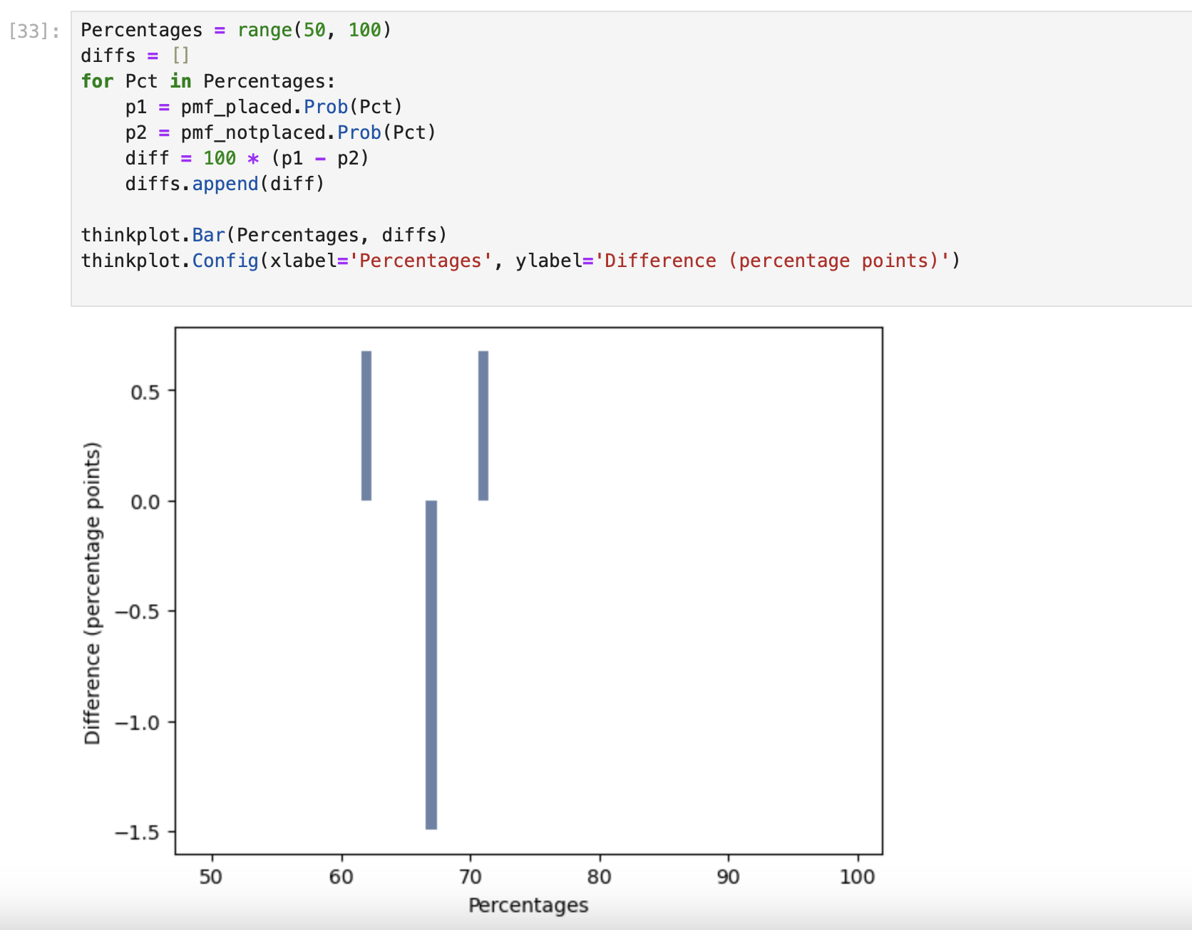
PMF Cont..
Comparing two PMF as percent difference

Slide 17
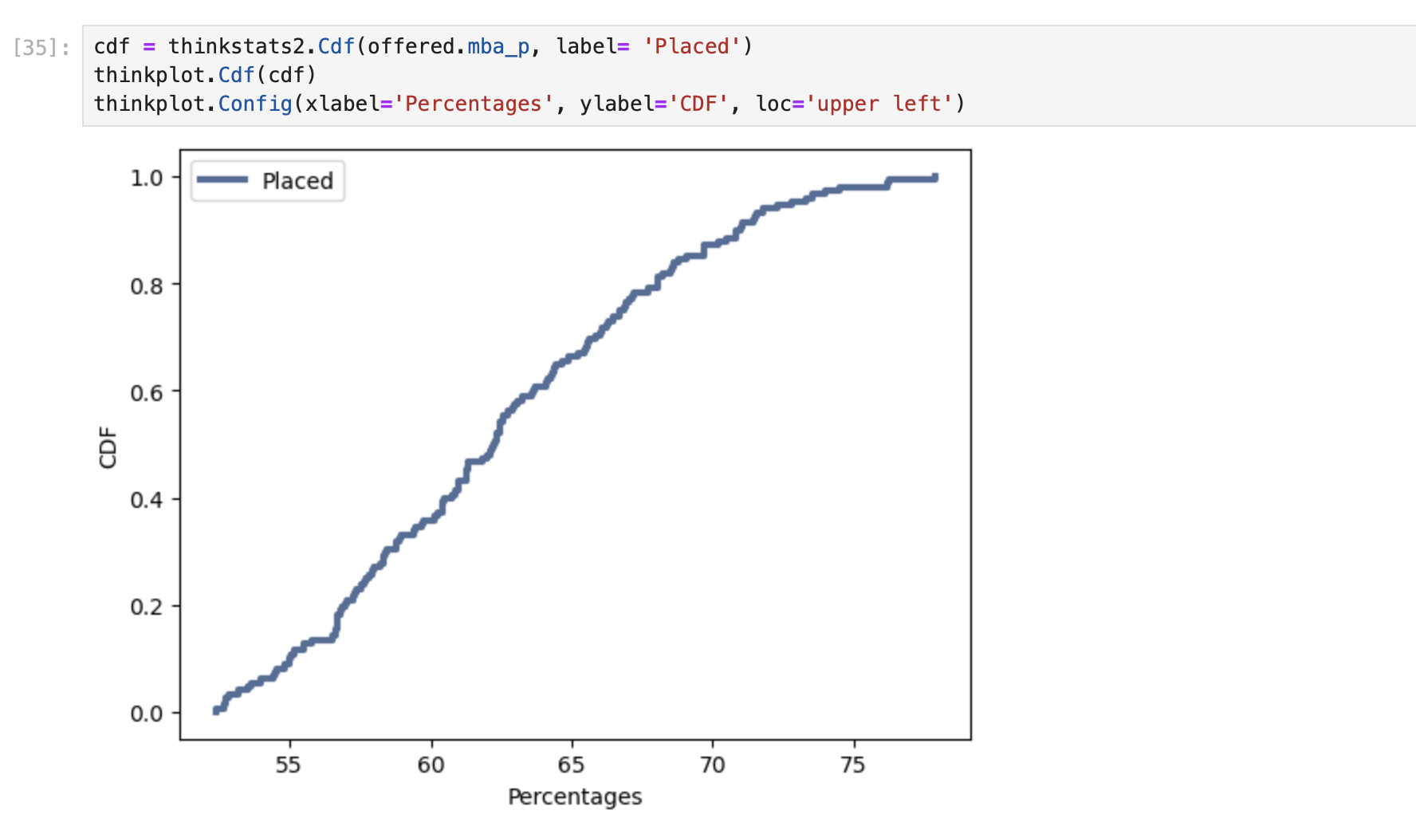
CDF
MBA Graduation percentage for students with job offers. You see its pretty notma

Slide 18
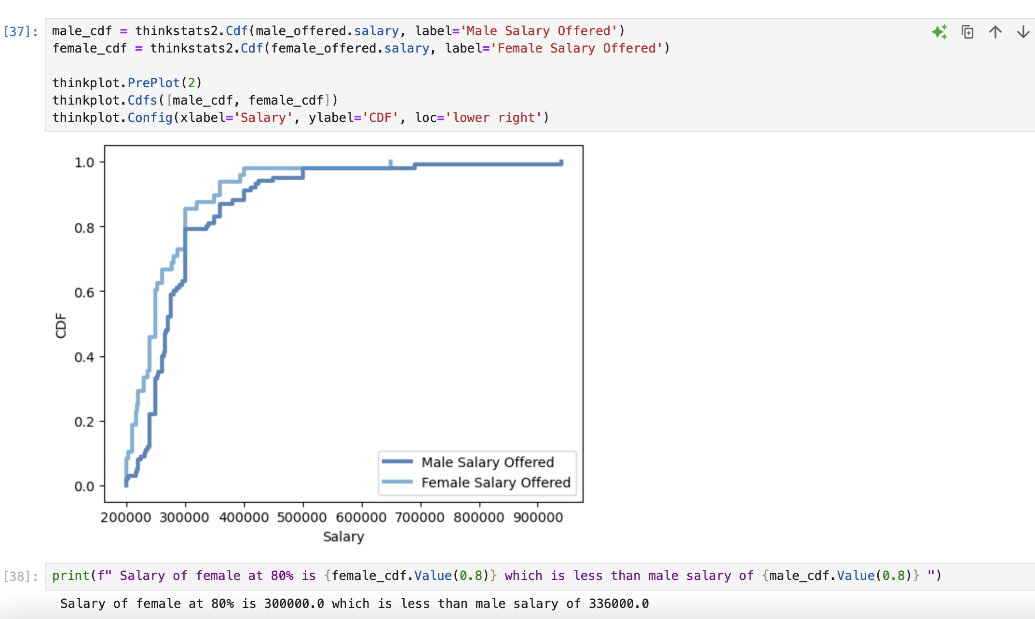
CDF cont..
Here is another CDF to compare the salaries of male and female students got placed
You will see that at any point the salary of male is higher than female counterpart.

Slide 19
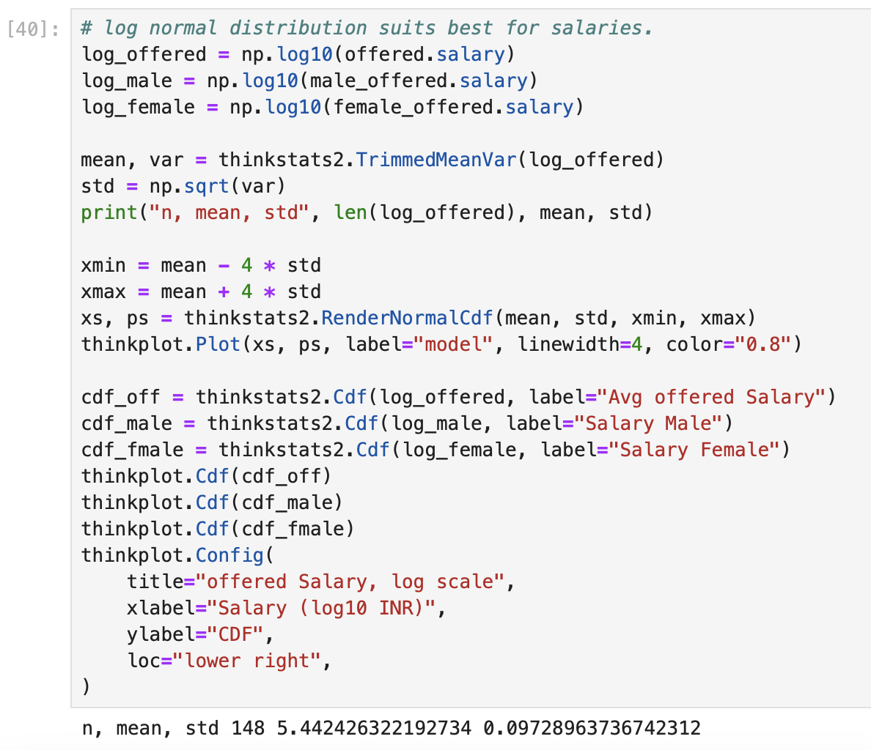
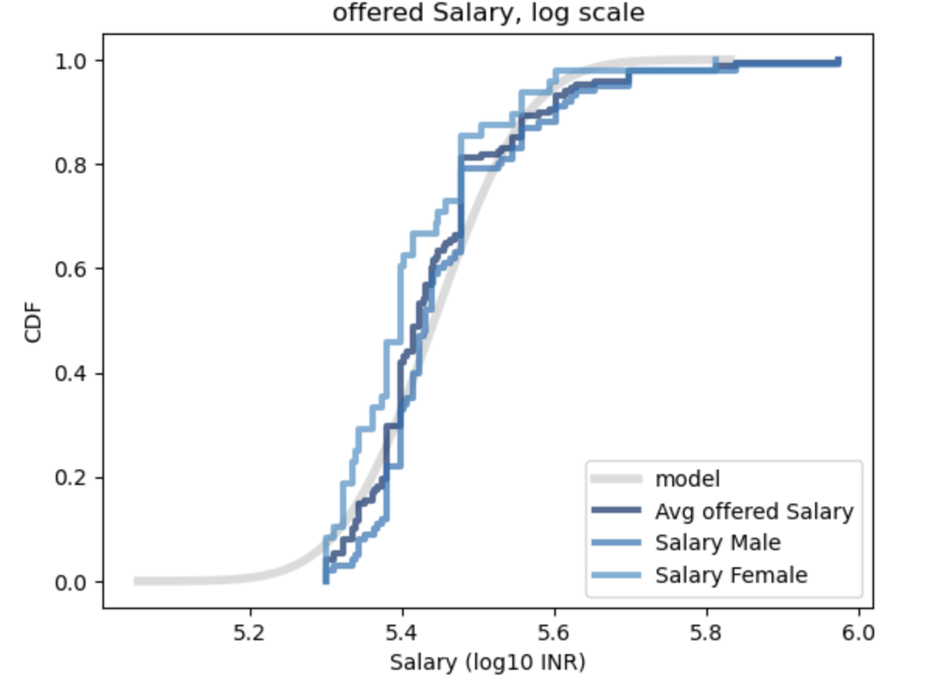
analytical distribution
As we are comparing salaries for different groups, lognormal distribution is the perfect fit for the analysis. Created a CDF for logarithmic salaries compared with salary offered, male and female. You can see there is a straightforward difference between Male and Female salaries. Where Male salaries falls pretty much with the average, females are offered lower salaries

Slide 20
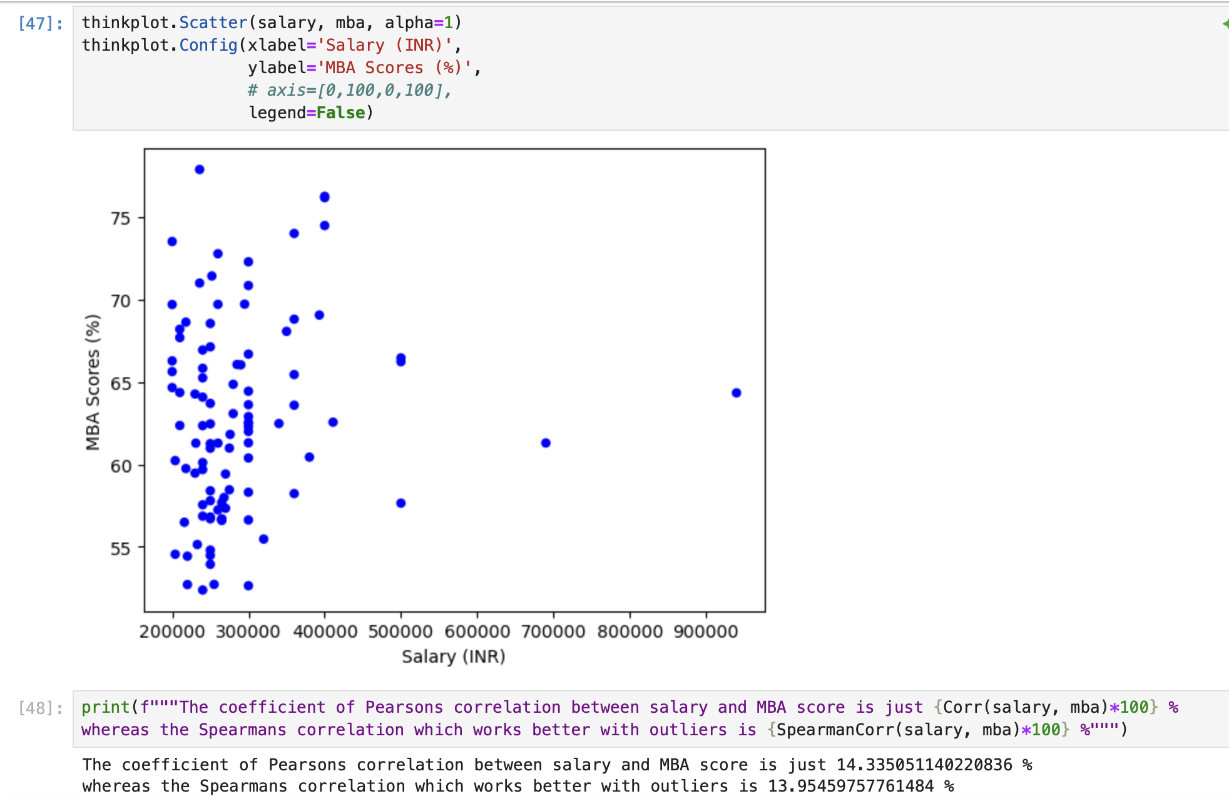
scatter plots

Slide 21
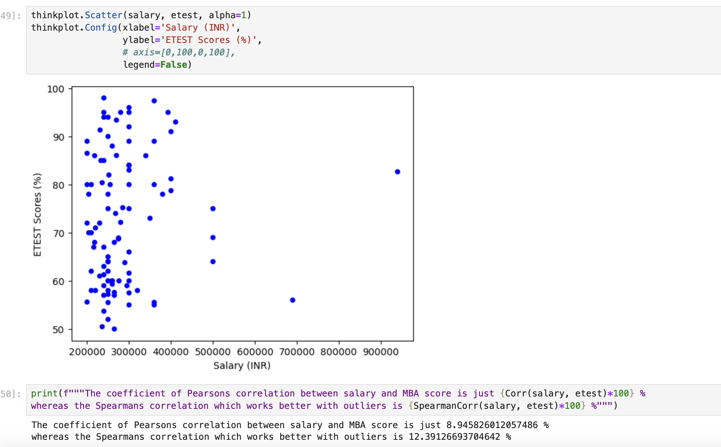
Scatter plot cont..

Slide 22
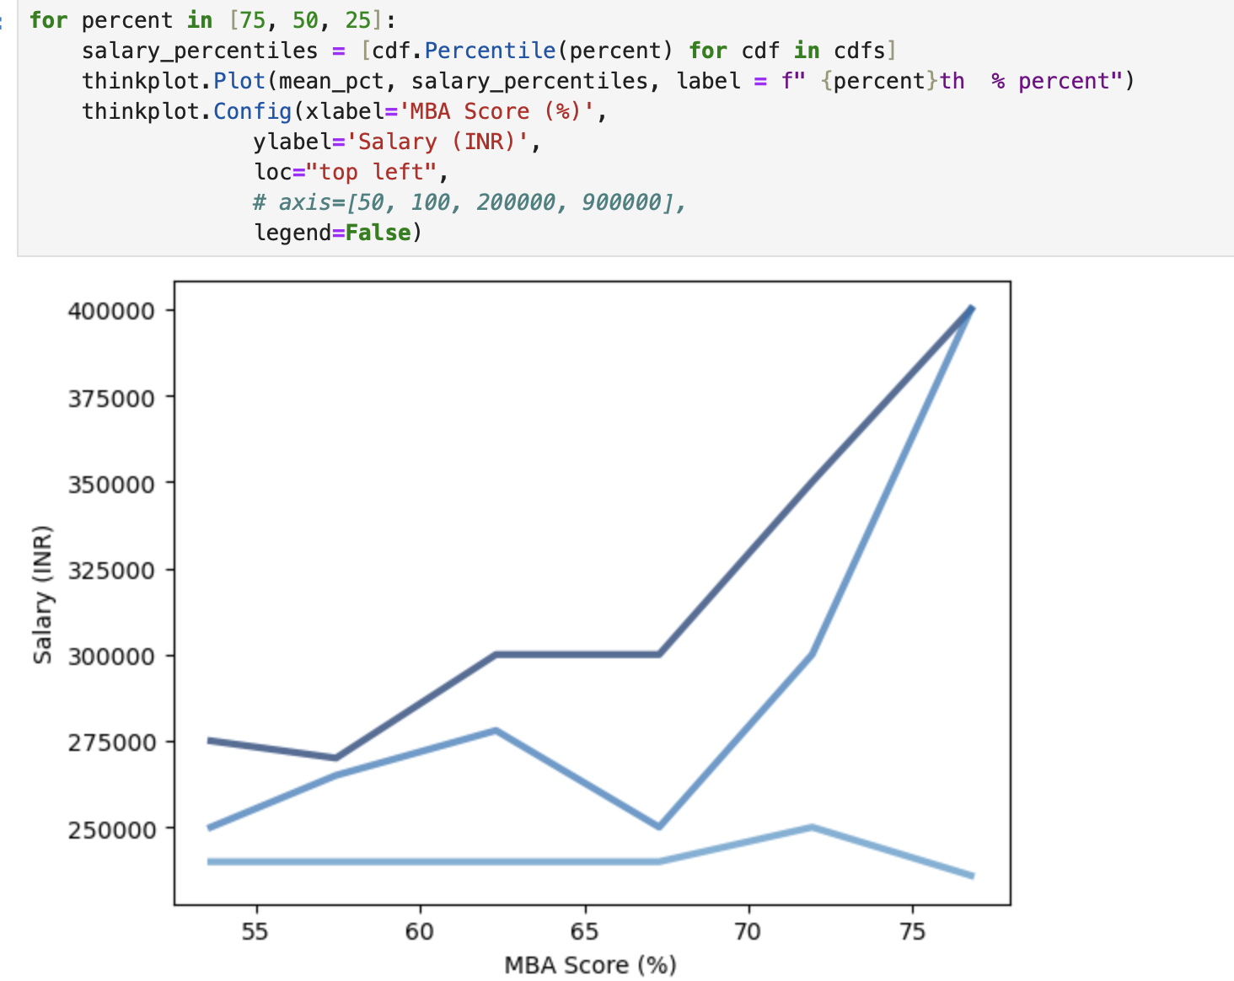
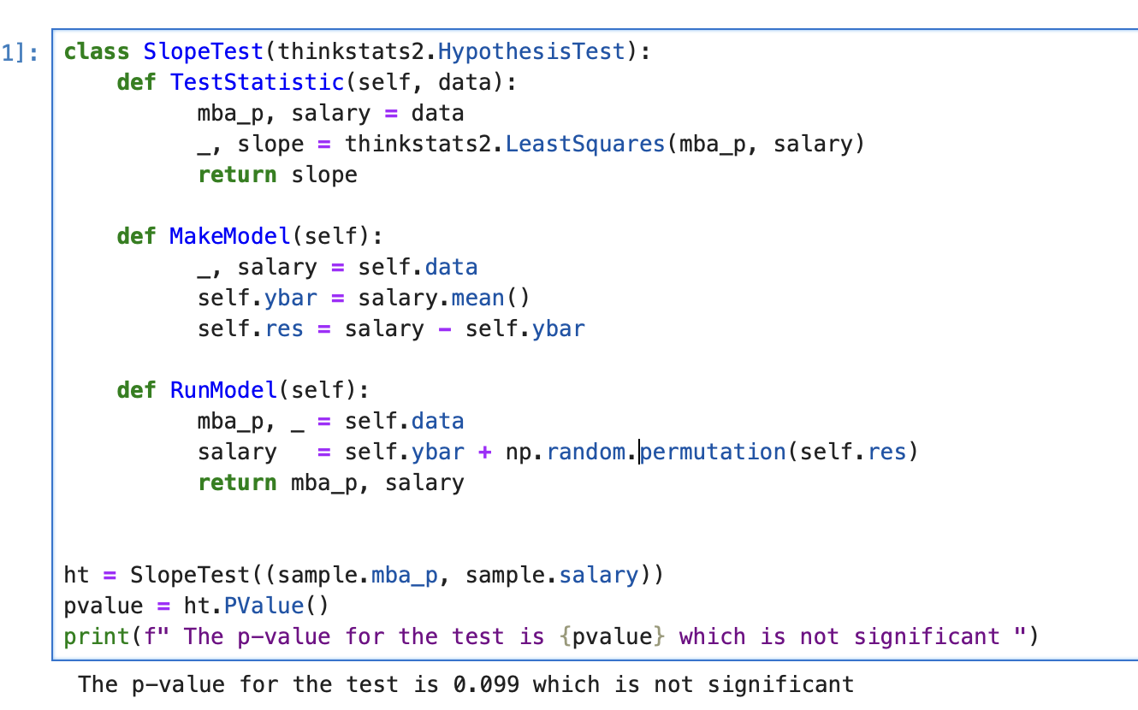
Relationship between variables
The relationship is Linear but as the null
hypothesis holds true as pvalue is > 0.05
Indicates there is no relationship between
The two variables

Slide 23
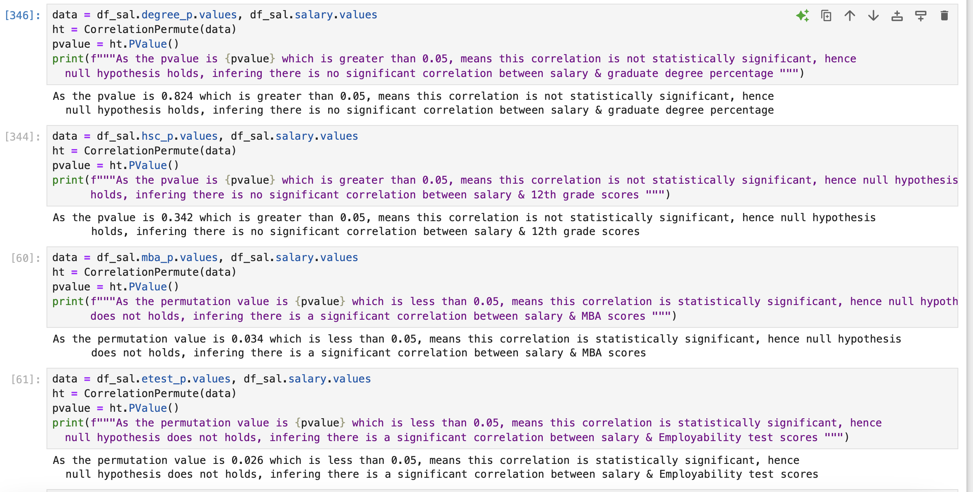
Hypothesis test
Except percentages in MBA & employability test, the other relations were not significant, hence the null
Hypothesis prevails, inferring that there is no direct relationship between two variables.

Slide 24
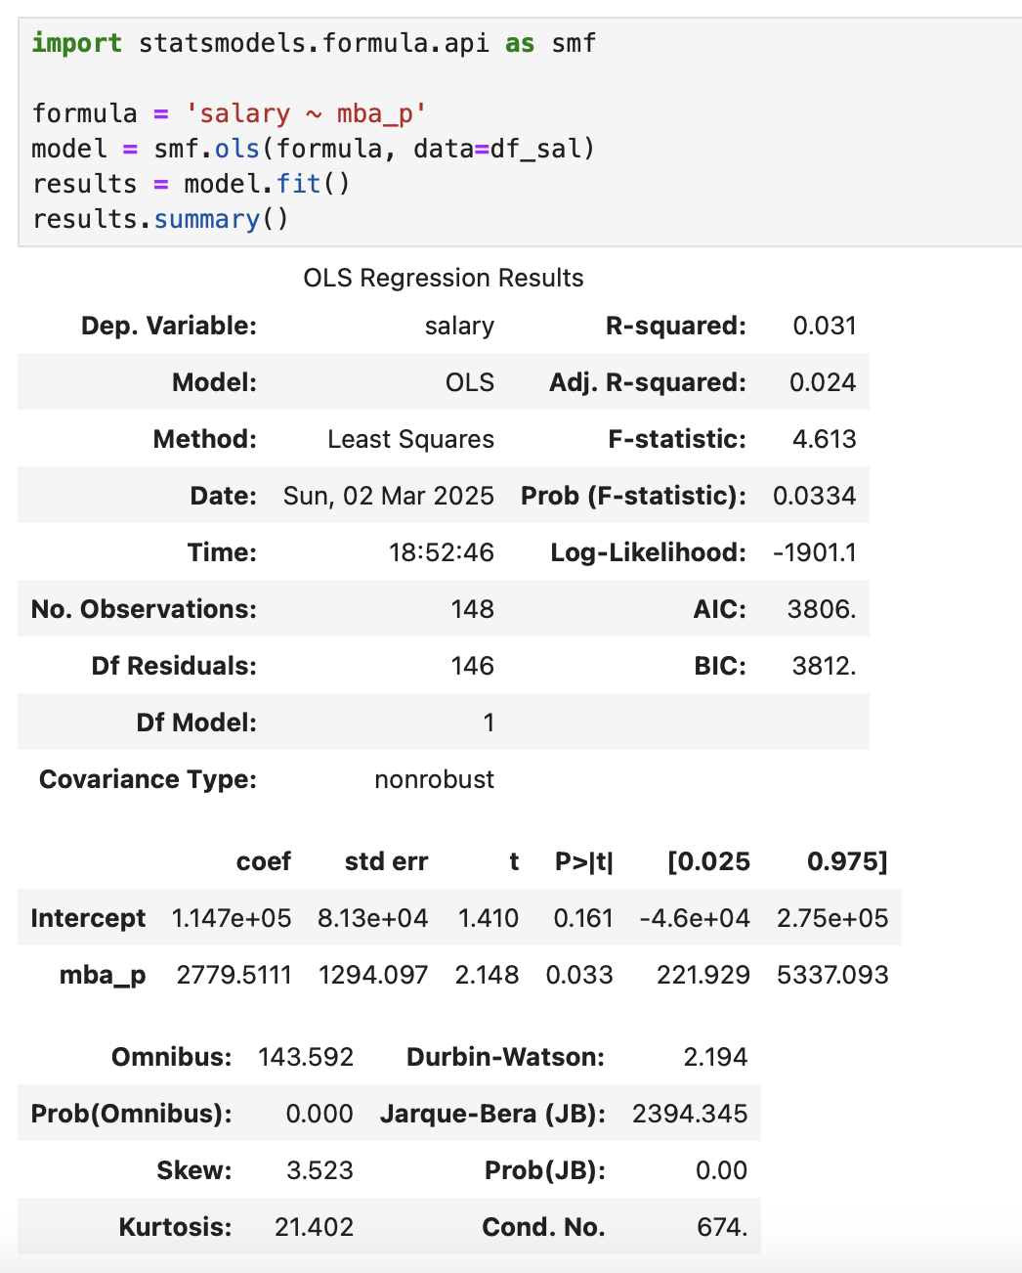
Regression
A regression model was built to predict salaries based
On the Graduation percentage points.
The results are significant with pvalue of 0.03

Slide 25
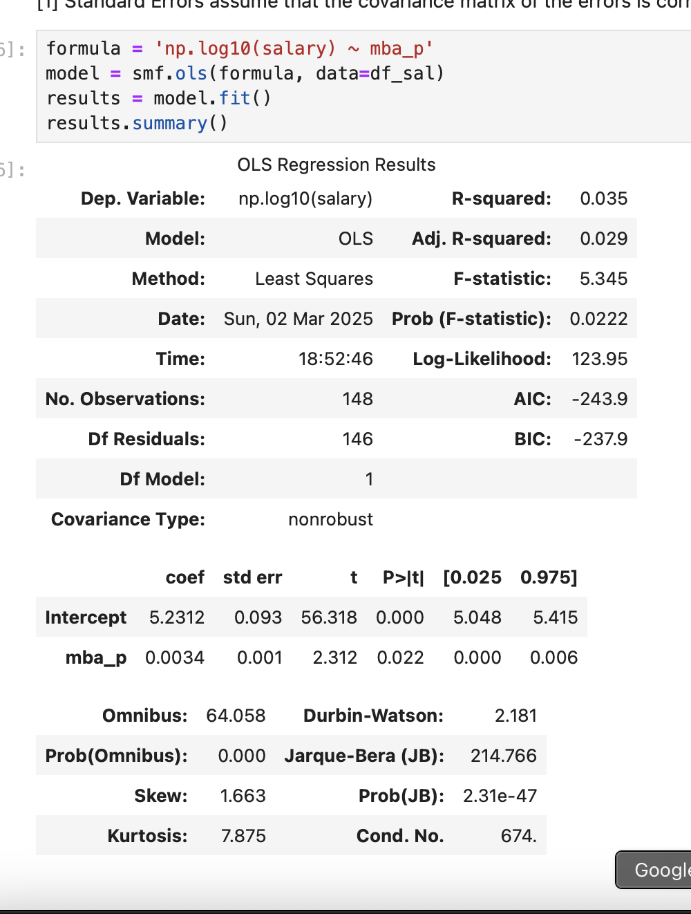
Regression Cont..
Lognormal regression model was tested to predict the
lognormal salary using mba graduation percentage points.
With Rsquared of 0.035 and pvalue of 0.02 the results were
Better compared to previous results.

Slide 26
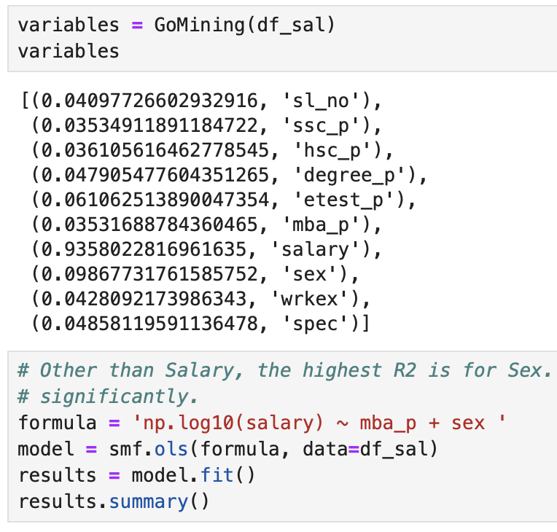
Regression cont..
Still is mining on data was done to find a better match.
A variable with good fit combined with MBA percent.
Sex & exmployement test (etest_p) percent were a good
Fit for the model. Etest_p shows higher R2 values but
Does not impact the results.

Slide 27
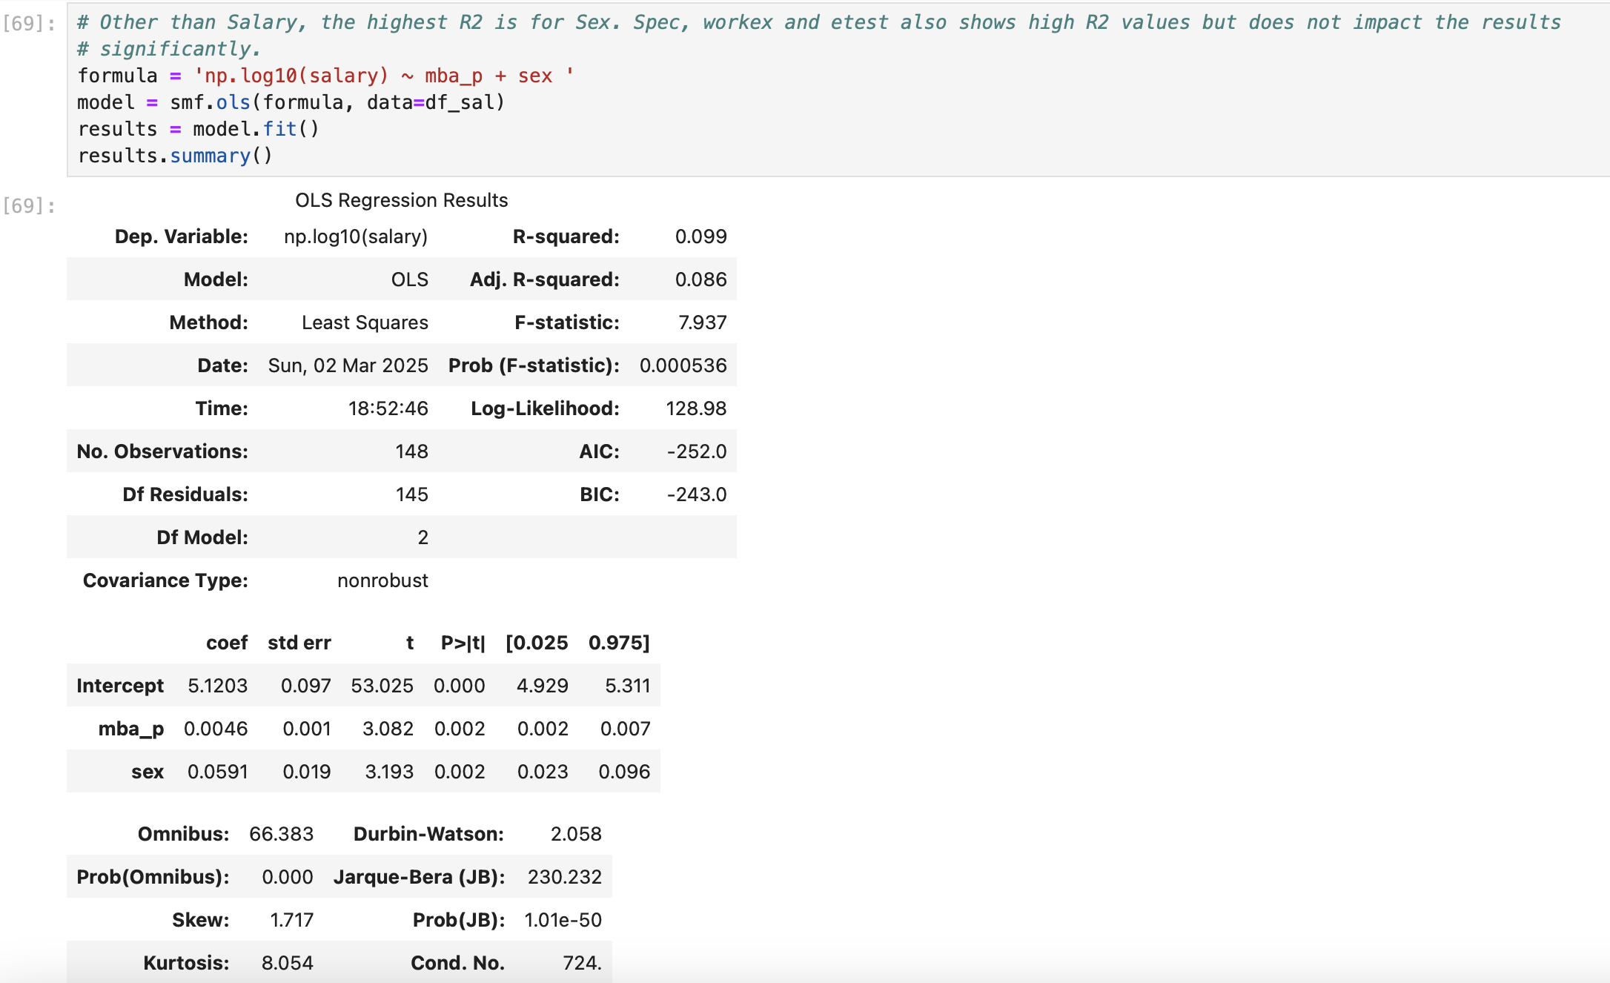
Regression Cont..

Slide 28
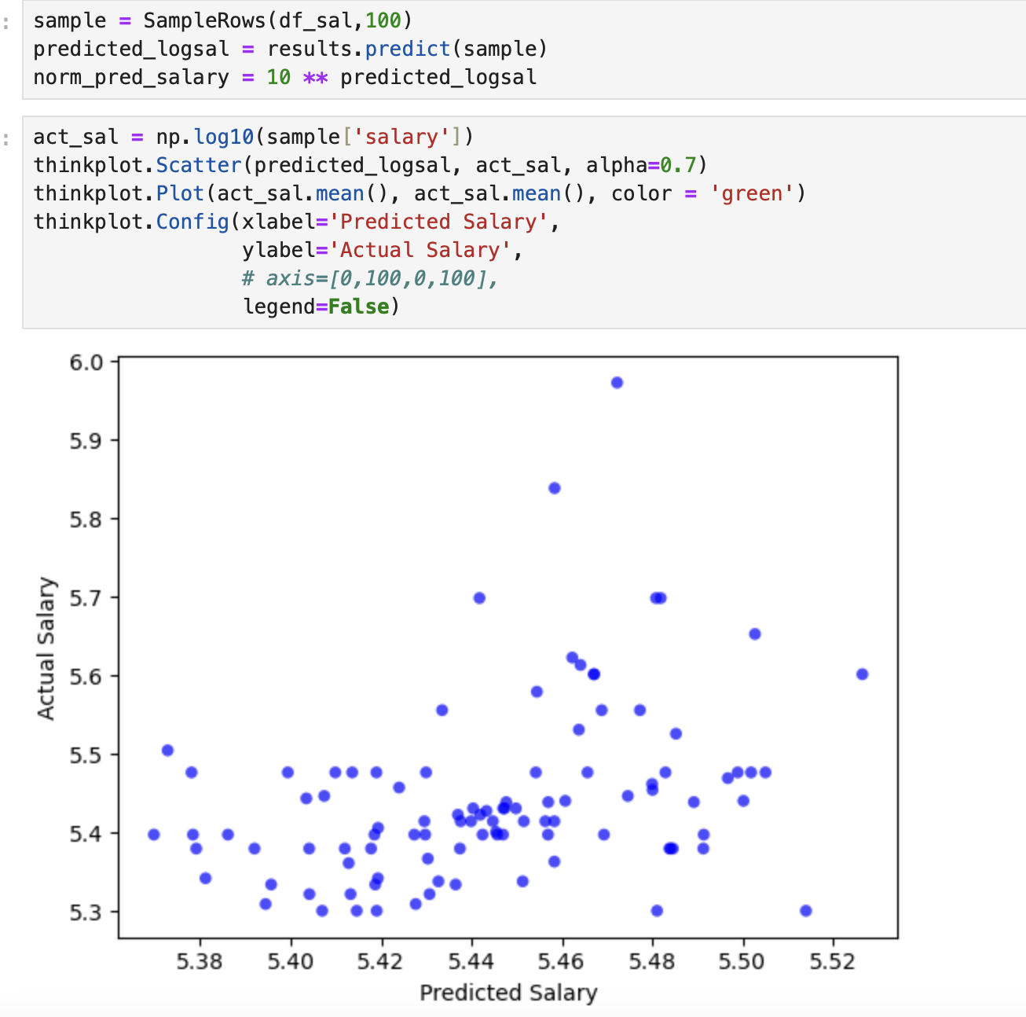
Regression cont..
The sample values were fitted against the model to predict the salary. The accuracy of model is low.

Slide 29
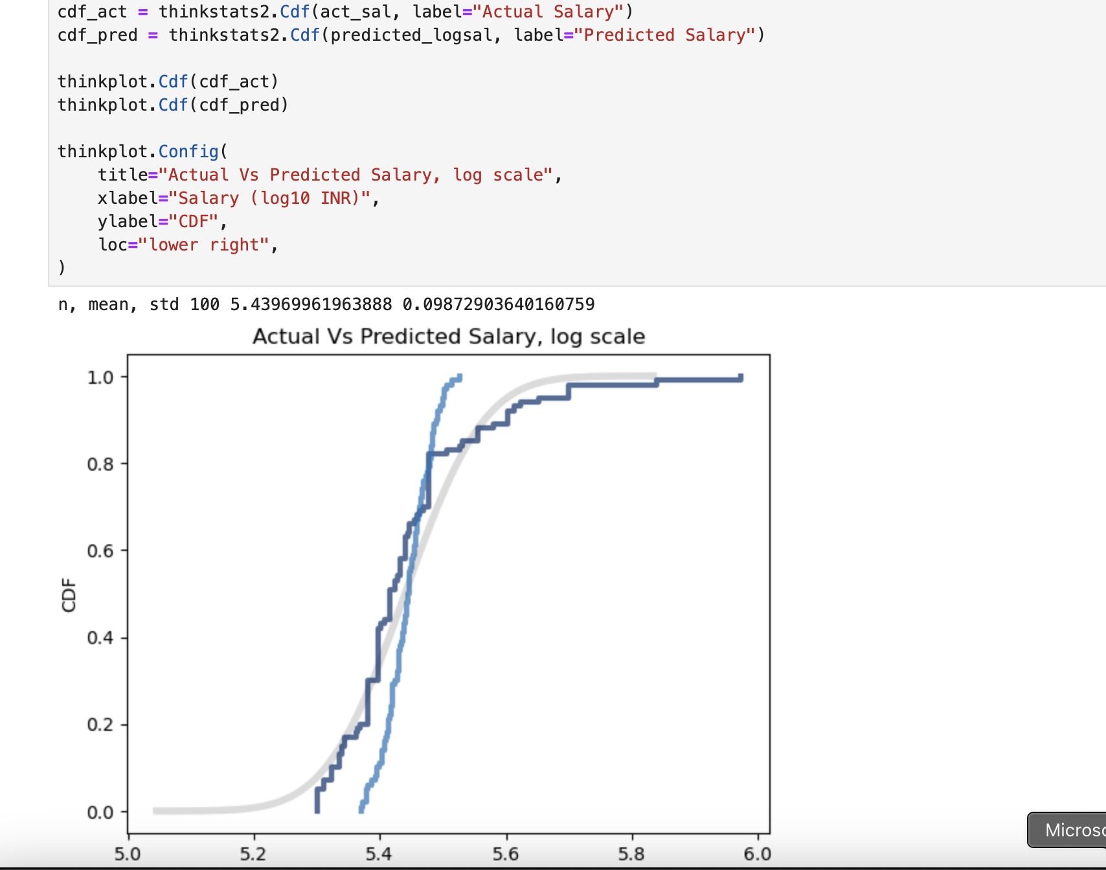
Regression cont..
As you can see the CDF of predicted values ( Light blue) is not following the normal path (Grey) and the actual salaries ( navy blue).

Slide 30
Conclusion
After going through all the findings, we can conclude that :
The percentage attained in your graduation have minimal effect on your salary
There is a slight difference between salaries offered to female vs male.

